Slide 1
O/1
Knapsack

Slide 2
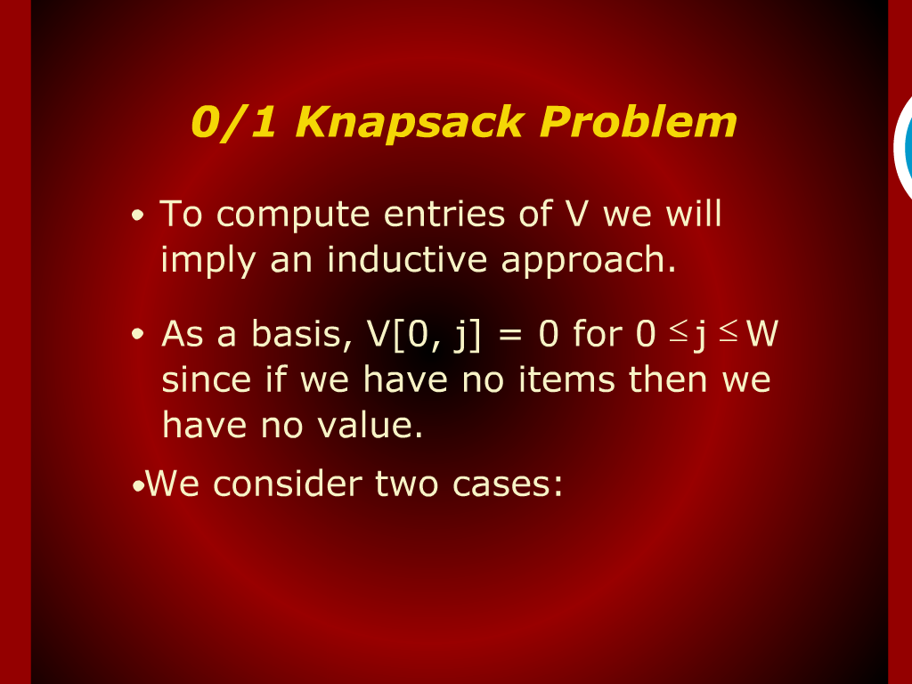
O/1 Knapsack Problem

Slide 3
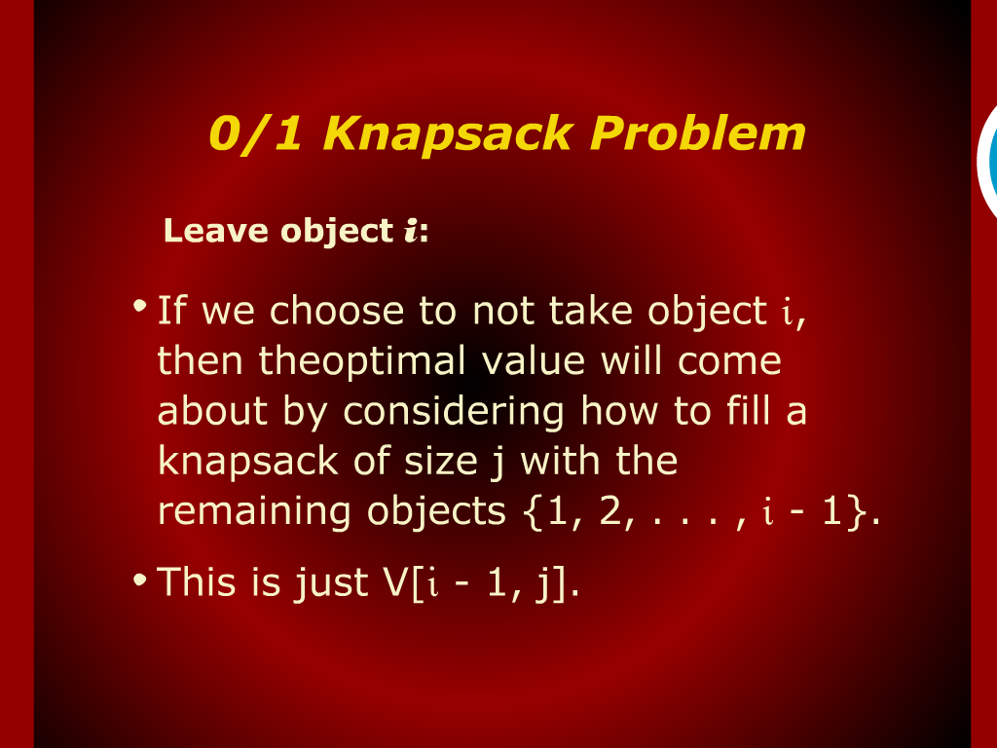
O/1 Knapsack Problem

Slide 4
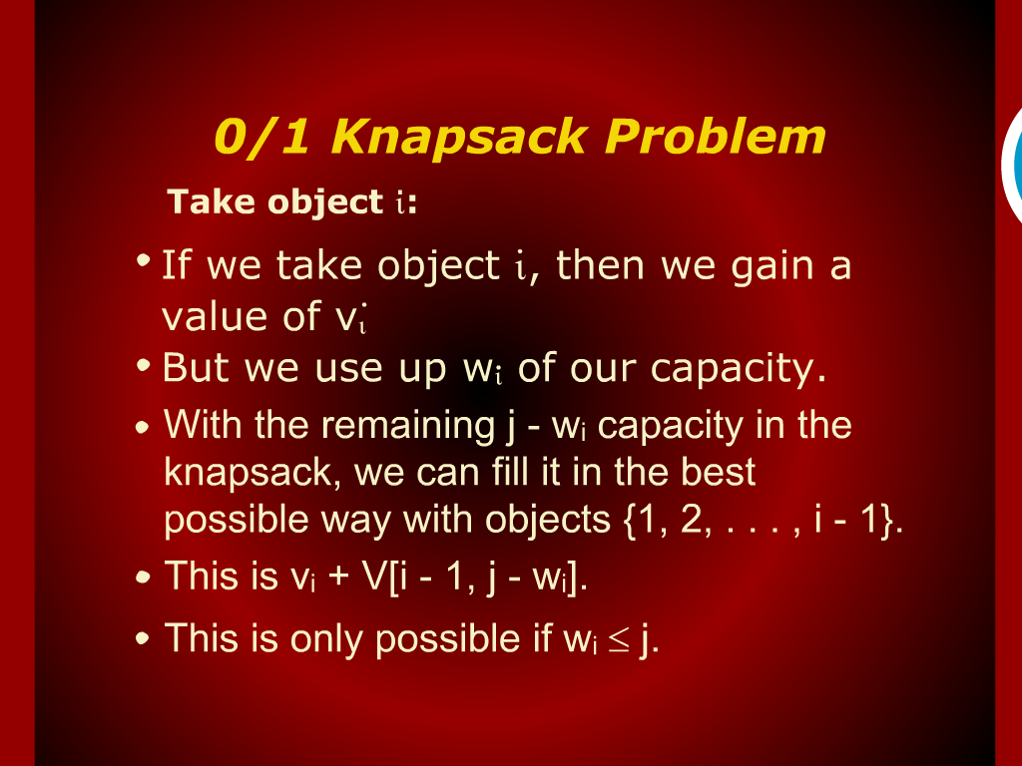
O/1 Knapsack Problem

Slide 5
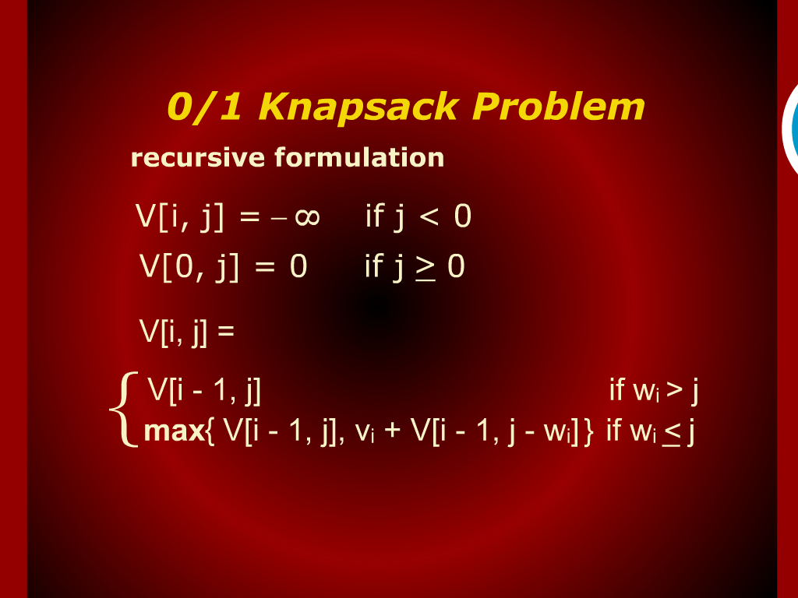
O/1 Knapsack Problem

Slide 6
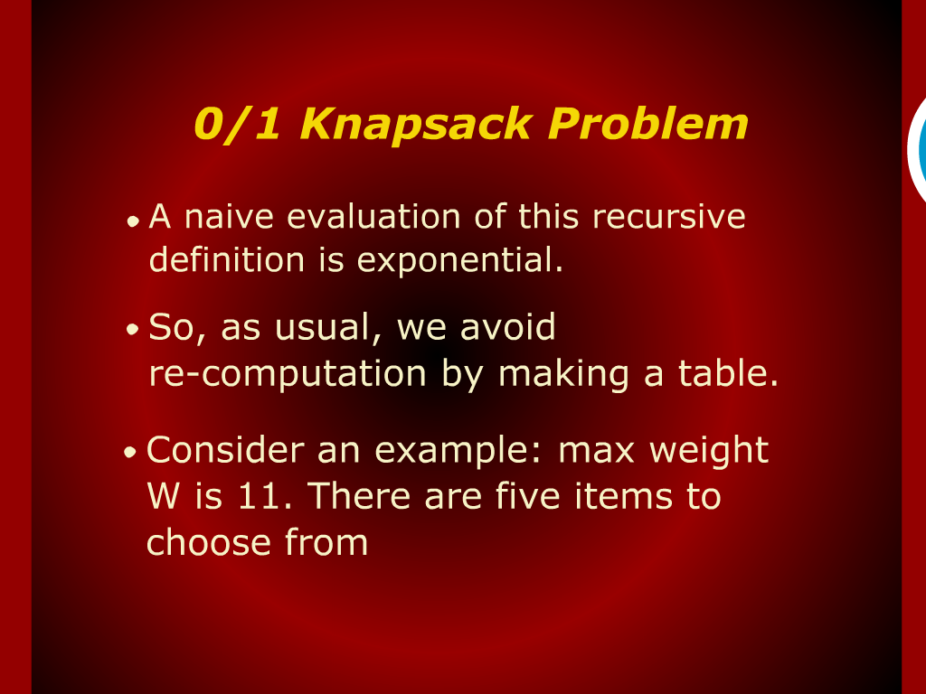
O/1 Knapsack Problem

Slide 7
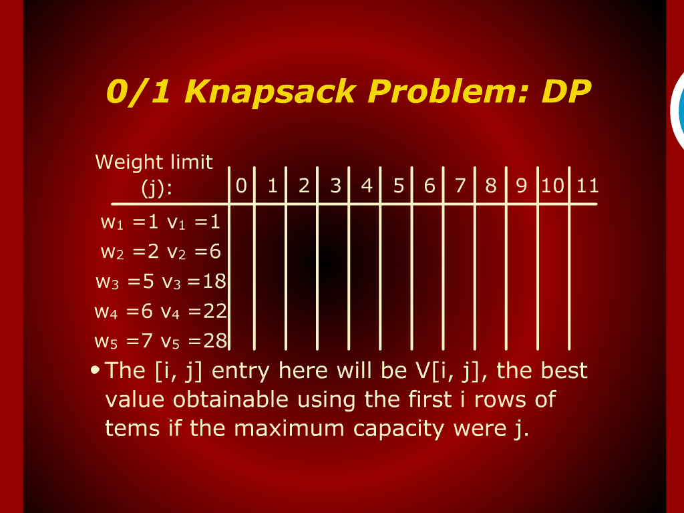
O/1 Knapsack Problem: DP

Slide 8
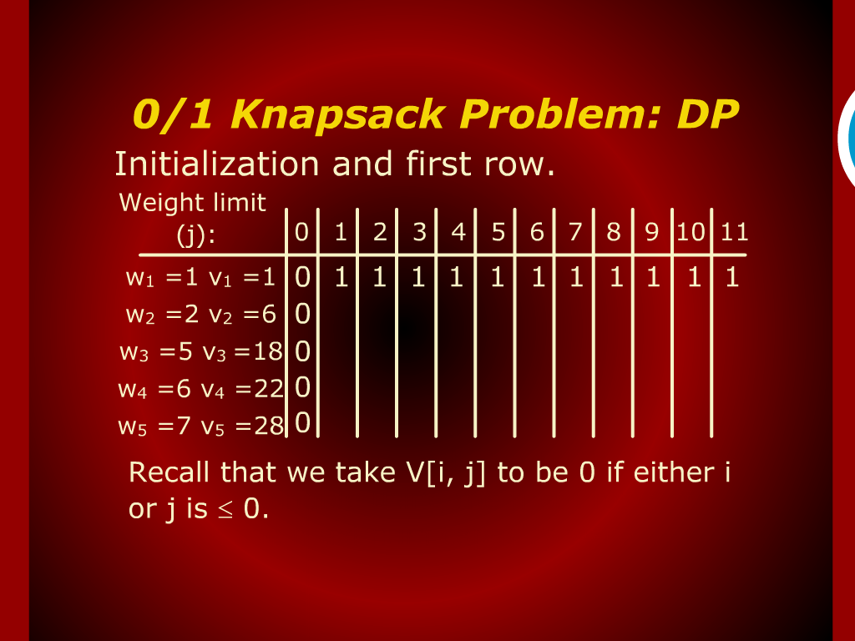
O/1 Knapsack Problem: DP

Slide 9
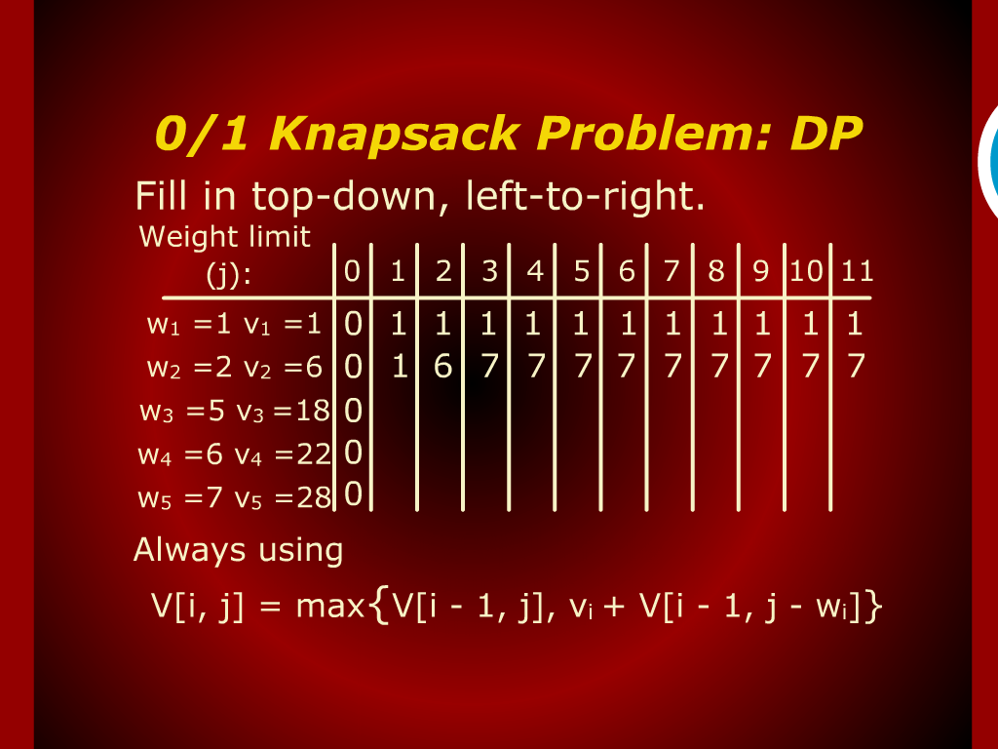
O/1 Knapsack Problem: DP

Slide 10
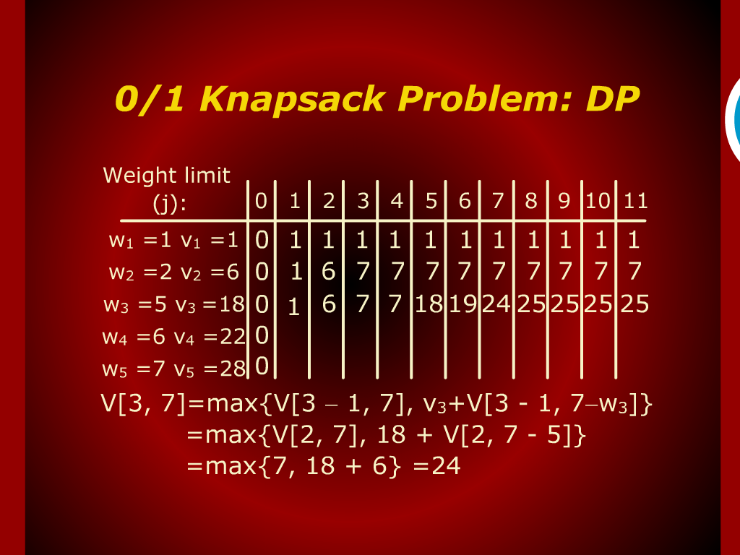
O/1 Knapsack Problem: DP

Slide 11
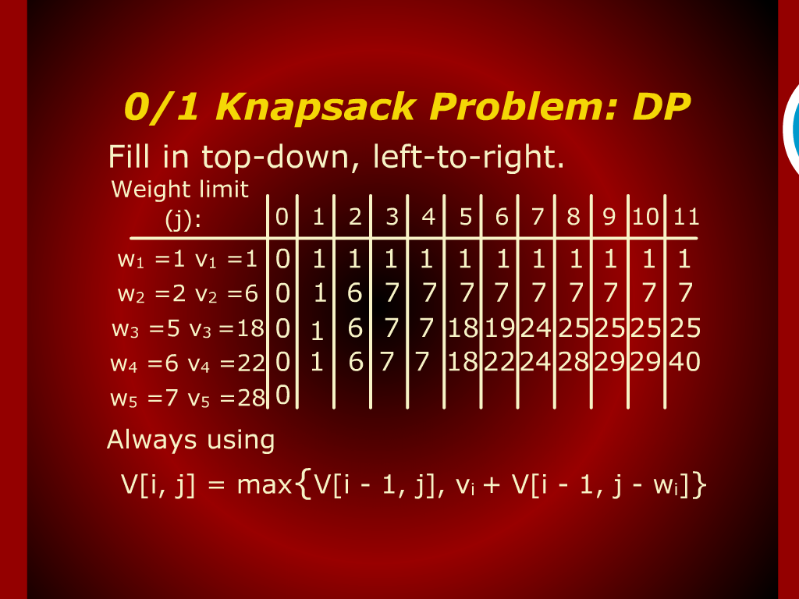
O/1 Knapsack Problem: DP

Slide 12
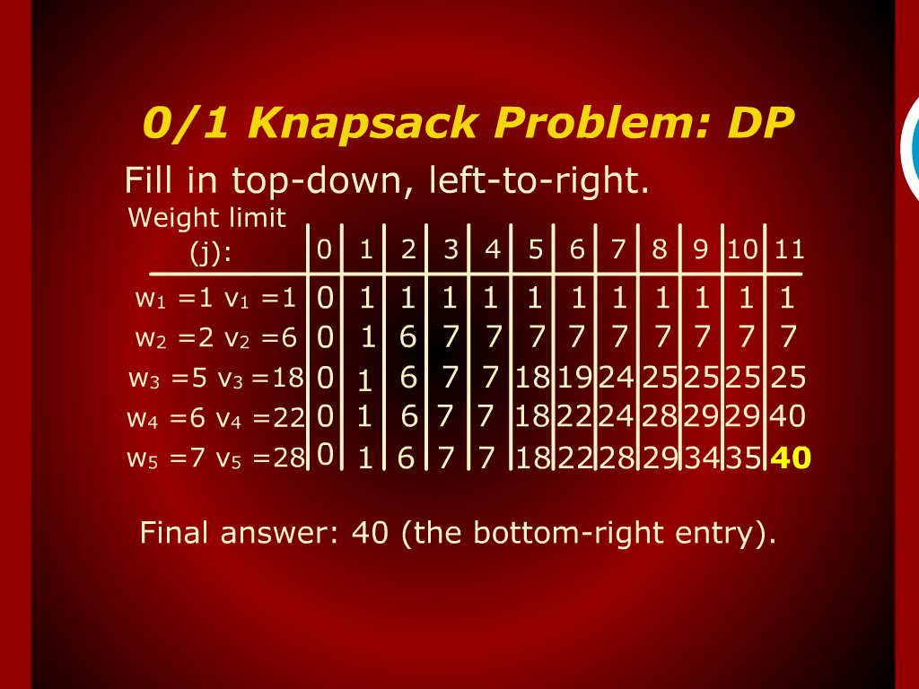
O/1 Knapsack Problem: DP

Slide 13
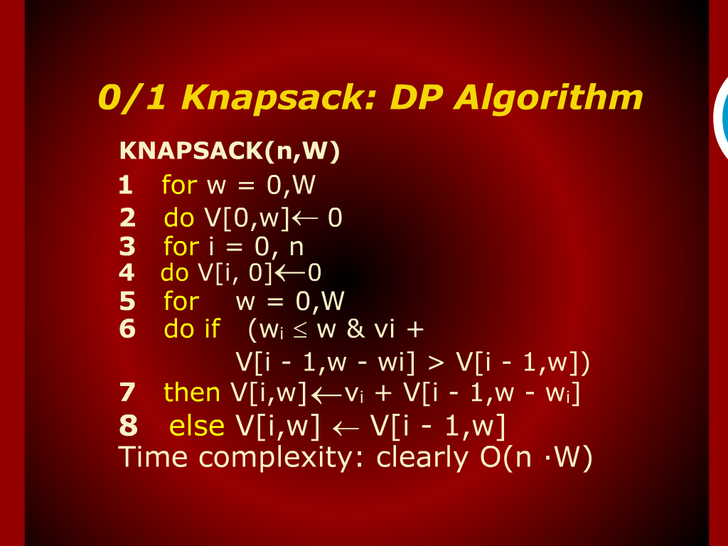
O/1 Knapsack: DP Algorithm

Slide 14
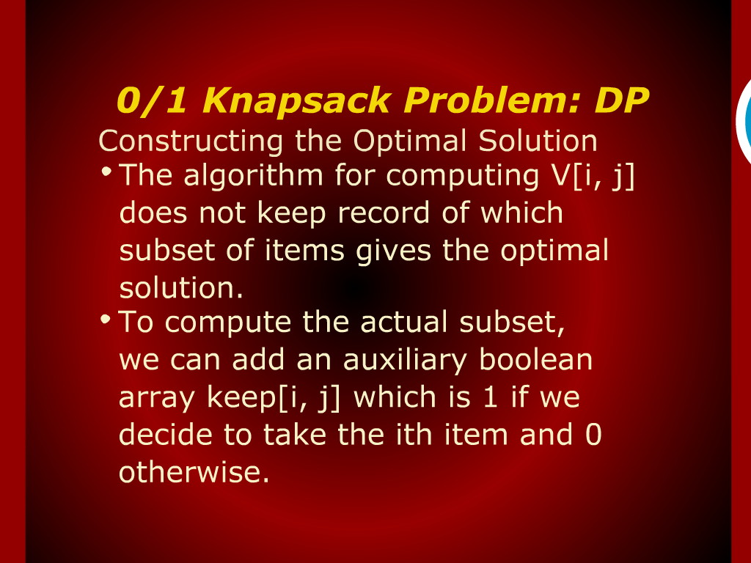
O/1 Knapsack Problem: DP

Slide 15
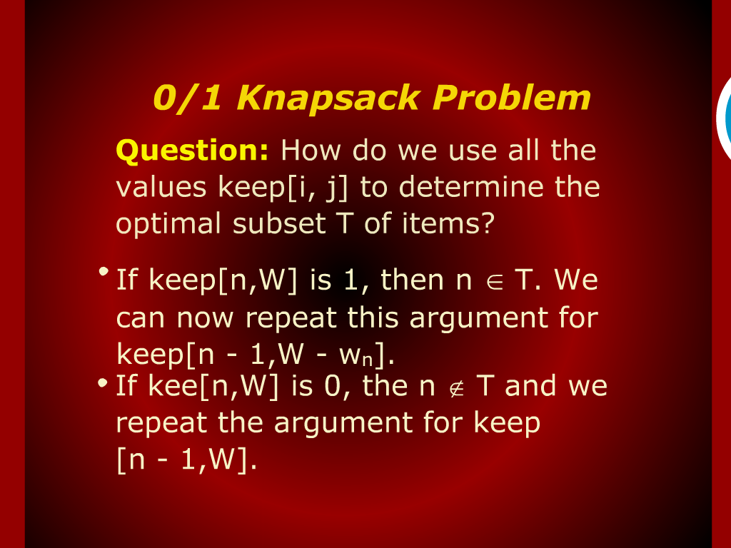
O/1 Knapsack Problem

Slide 16
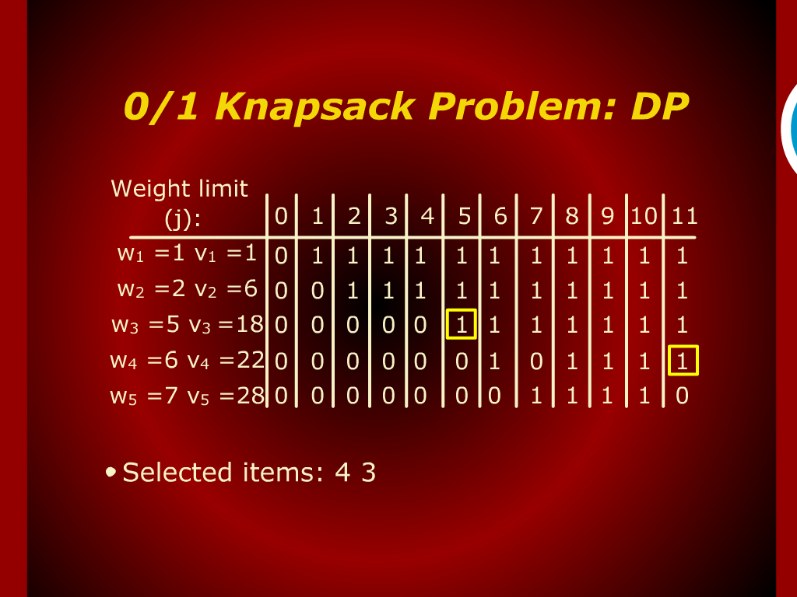
O/1 Knapsack Problem: DP

Slide 17
Design and Analysis
of
Algorithms

Slide 18
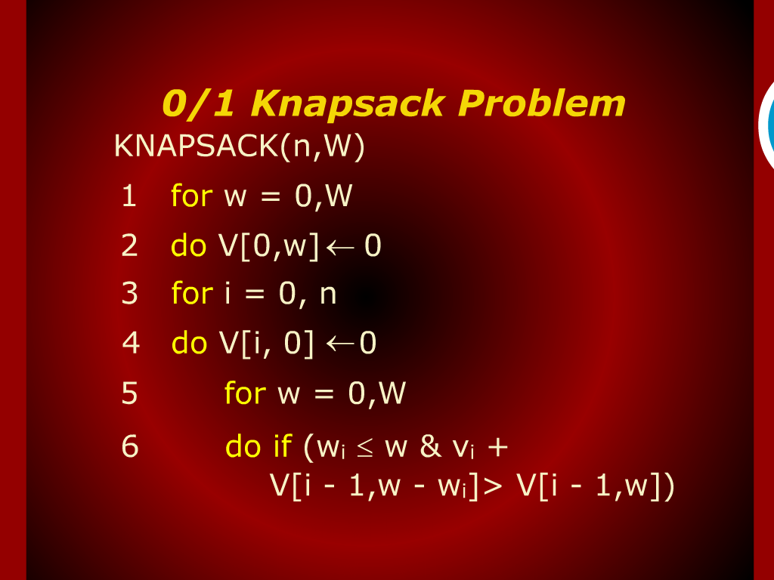
O/1 Knapsack Problem

Slide 19
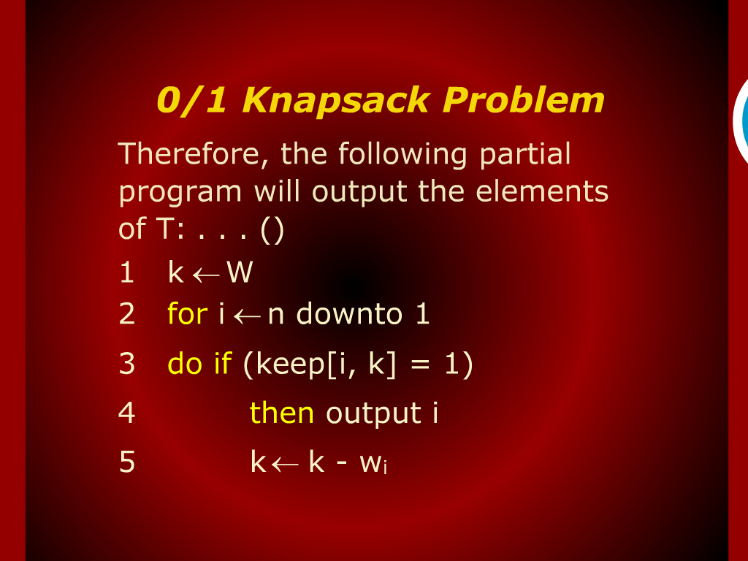
O/1 Knapsack Problem

